Slide 1
BugTrap iteration 2
Group 03
Kwinten Buytaert, Mathias Dekempeneer, Vincent Derkinderen & Ben Goethuys

Slide 2
Contents
General overview
Design choices:
Undo
Mailboxes
Milestones
Bugreport states
Testing

Slide 3
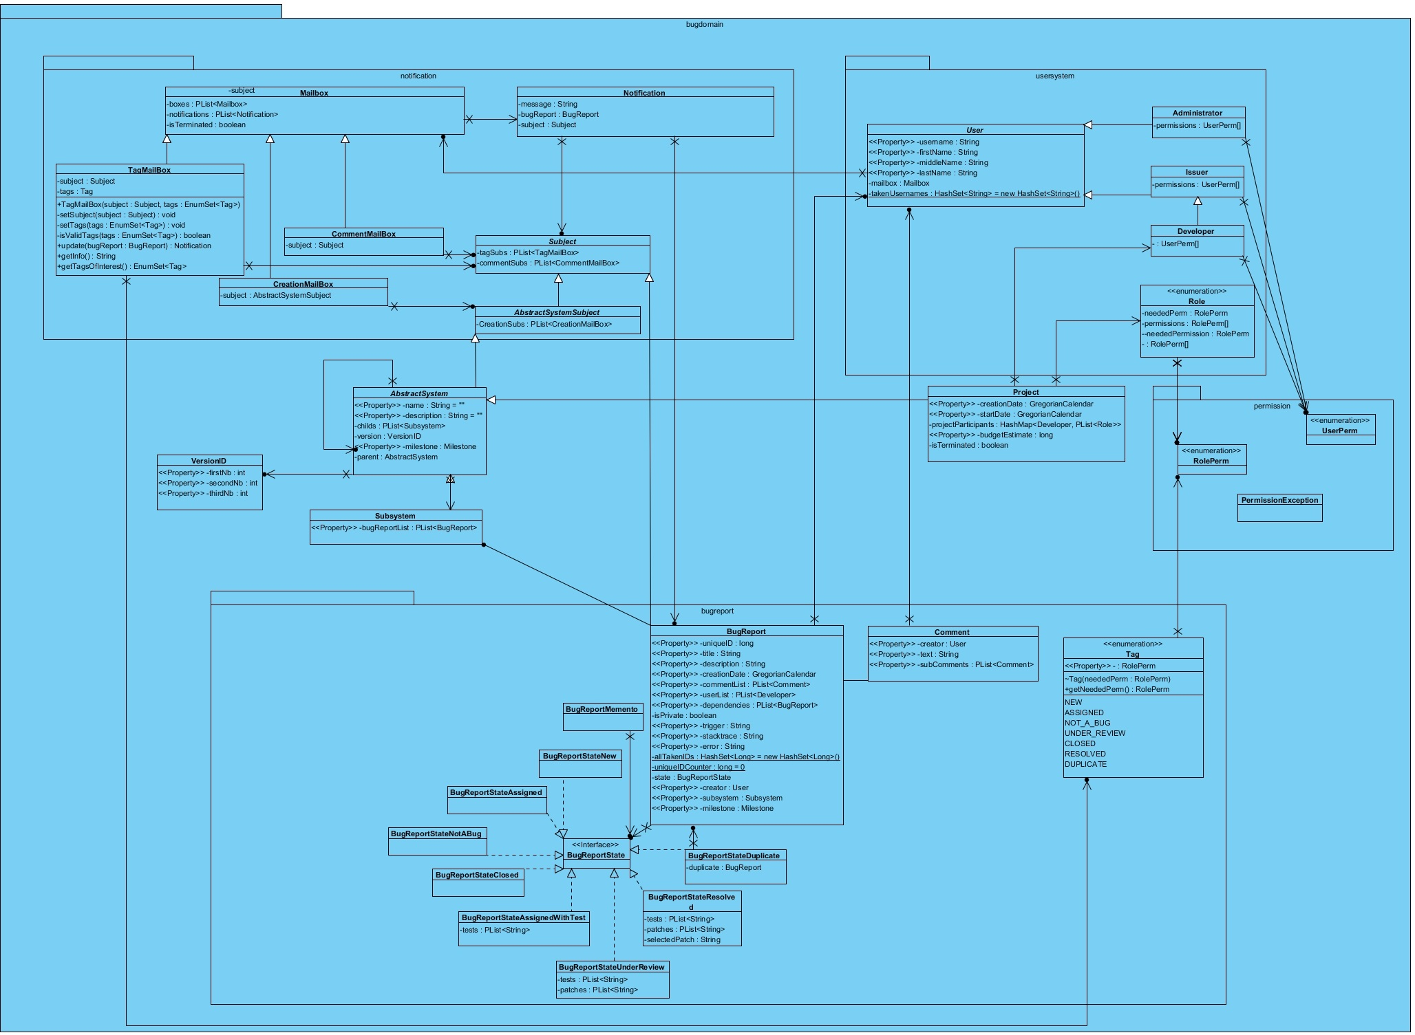

Slide 4
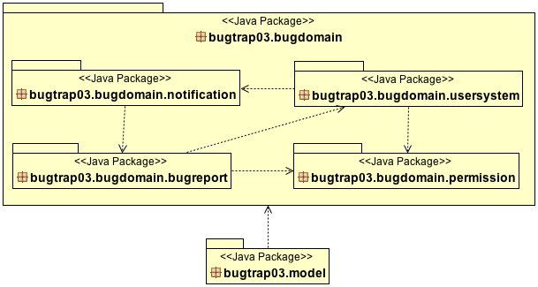
General Overview

